Slide 1
Computer graphics
Semester 5 – Department of Informatics ITS 2017

Slide 2
Viewing
Classical Viewing
Computer Viewing

Slide 3
Objectives
Introduce the mathematics of projection
Introduce OpenGL viewing functions
Look at alternate viewing APIs

Slide 4
Computer Viewing
There are three aspects of the viewing process, all of which are implemented in the pipeline,
Positioning the camera
Setting the model-view matrix
Selecting a lens
Setting the projection matrix
Clipping
Setting the view volume

Slide 5
The OpenGL Camera
In OpenGL, initially the object and camera frames are the same
Default model-view matrix is an identity
The camera is located at origin and points in the negative z direction
OpenGL also specifies a default view volume that is a cube with sides of length 2 centered at the origin
Default projection matrix is an identity

Slide 6
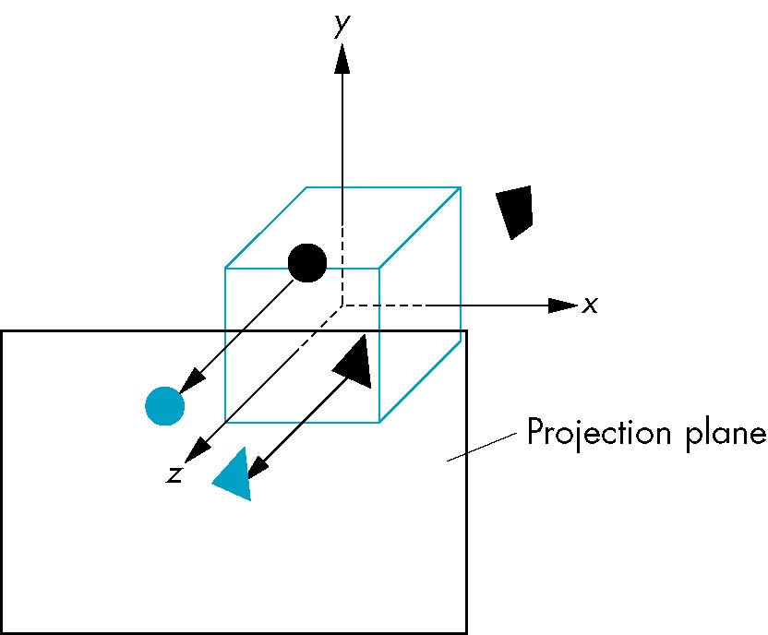
Default Projection
Default projection is orthogonal
clipped out
2
z=0

Slide 7
Moving the Camera Frame
If we want to visualize object with both positive and negative z values we can either
Move the camera in the positive z direction
Translate the camera frame
Move the objects in the negative z direction
Translate the world frame
Both of these views are equivalent and are determined by the model-view matrix
Want a translation (Translate(0.0,0.0,-d);)
d > 0

Slide 8
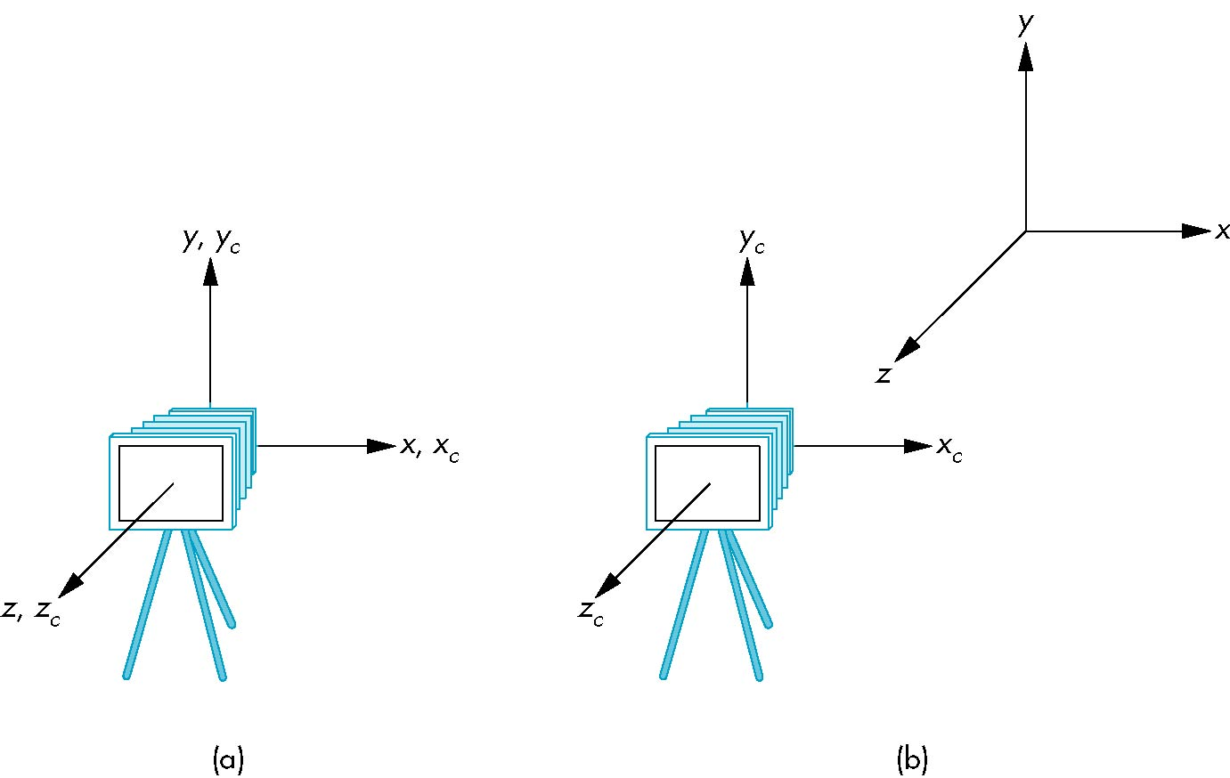
Moving Camera back from Origin
frames after translation by –d
d > 0
default frames

Slide 9
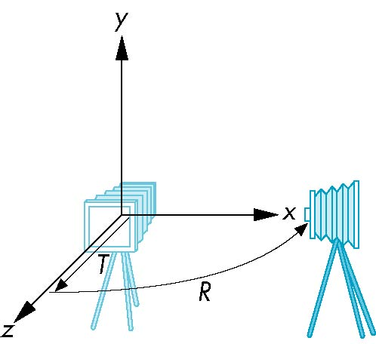
Moving the Camera
We can move the camera to any desired position by a sequence of rotations and translations
Example: side view
Rotate the camera
Move it away from origin
Model-view matrix C = TR

Slide 10
OpenGL code
Remember that last transformation specified is first to be applied
// Using mat.h
mat4 t = Translate (0.0, 0.0, -d);
mat4 ry = RotateY(90.0);
mat4 m = t*ry;

Slide 11

Short Question
What should we do if we want to have an isometric view of a cube?
See text page 207-209.

Slide 12
The LookAt Function
The GLU library contains the function gluLookAt to form the required modelview matrix through a simple interface
Note the need for setting an up direction
Replaced by LookAt() in mat.h
Can concatenate with modeling transformations
Example: isometric view of cube aligned with axes
mat4 mv = LookAt(vec4 eye, vec4 at, vec4 up);

Slide 13
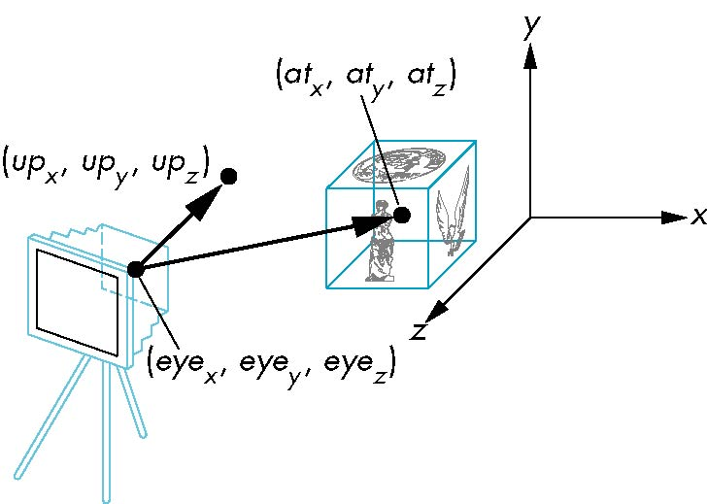
LookAt
LookAt(eye, at, up)

Slide 14
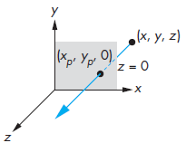
Orthogononal Projections
A special case of parallel projections
Projectors are parallel and perpendicular to the view plane

Slide 15
Homogeneous Coordinate Representation
default orthographic projection
x_{p} = x
y_{p} = y
z_{p} = 0
w_{p} = 1
p_{p} = Mp
M =
In practice, we can let M = I and set
the z term to zero later

Slide 16
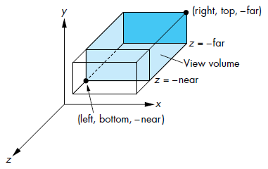
OpenGL Orthogonal Viewing
mat4 Ortho(left,right,bottom,top,near,far)
near and far measured from camera

Slide 17
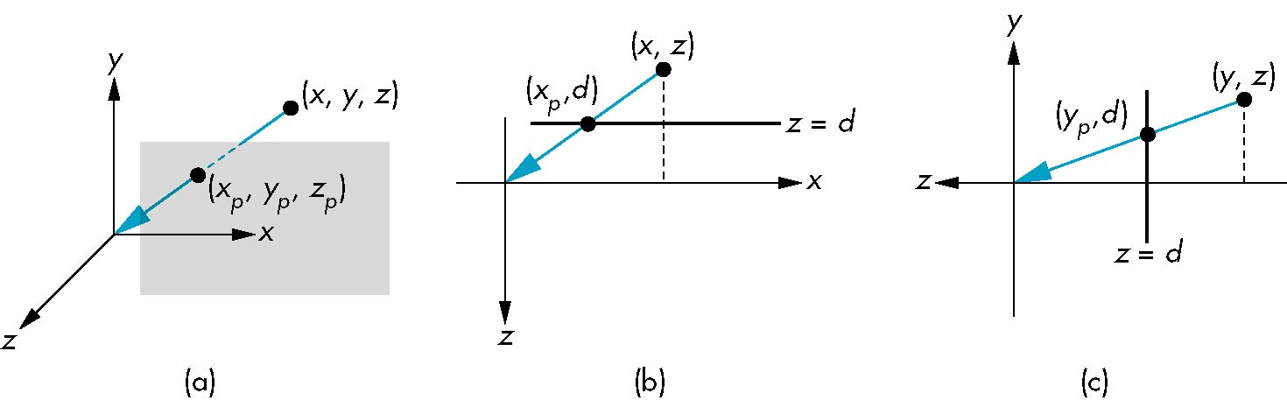
Simple Perspective
Center of projection at the origin
Projection plane z = d, d < 0

Slide 18
Perspective Equations
Consider top and side views
x_{p} =
y_{p} =
z_{p} = d

Slide 19
Homogeneous Coordinate Form
consider q = Mp where
M =
p =
⇒ q =

Slide 20
Perspective Division
However w ≠ 1, so we must divide by w to return from homogeneous coordinates
This perspective division yields
the desired perspective equations
We will consider the corresponding clipping volume with mat.h functions that are equivalent to deprecated OpenGL functions
x_{p} =
y_{p} =
z_{p} = d

Slide 21
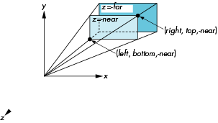
OpenGL Perspective
Frustum(left,right,bottom,top,near,far)

Slide 22
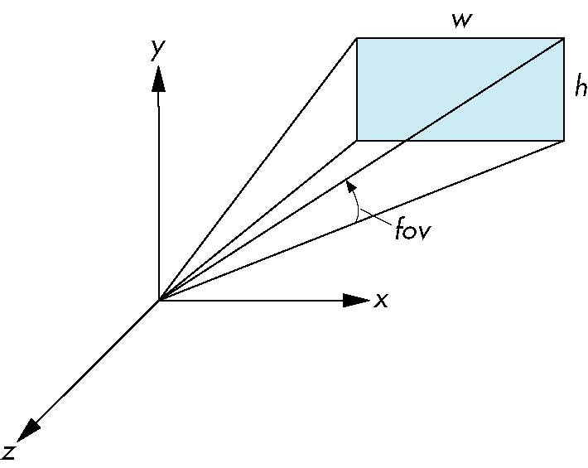
Using Field of View
With Frustum it is often difficult to get the desired view
Perspective(fovy, aspect, near, far) often provides a better interface
front plane
aspect = w/h

Slide 23
Contoh Program
Orthogonal View
Perspective View (using Frustum)
Perspective View (using Perspective)

Slide 24
Latihan 1 – Displaying Meshes
Download file honolulu.raw
Ikuti langkah-langkah yang ada di buku halaman 241-249

Slide 25
Latihan 2 – Projections and Shadows
Ikuti langkah-langkah yang ada di buku halaman 249-253 untuk membuat efek shadow/bayangan
Homework:
Kerjakan latihan 1 dan 2 secara berkelompok,
tiap kelompok terdiri atas 2-3 orang.
Waktu pengerjaan: 1 minggu

Slide 26
Next Week: Lighting and Shading
Read Textbook Chapter 5

